Slide 1

Mobile Application Development
Course Code:CSE-410
Service Finder App
Presented By:
Mamunur Roshid (371)

Slide 2
Problem Statement
People Depend on Third Party for Service
Causes Relatively High Cost
Reduced earnings for service providers

Slide 3
Our Solution
Remove the third party and make direct communication between service provider and service taker so that people get service in low price and service provider earn more.

Slide 4
App Main Features
Secured Signup and Login System
Reset Password Feature
Find service provider around current location
Direct Contact with the provider
Give Rating and Feedback
Update user profile
Administration feature from firebase
View Rating and Review
Place Order
Confirm Order, Decline Order
Get Direction on Google Map
Give Rating and Review

Slide 5
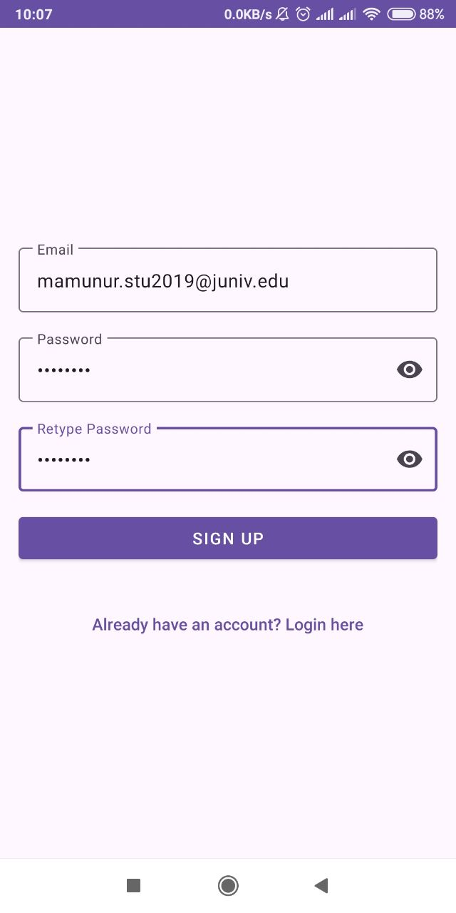
Signup Feature
Firebase Auth is used
Email verification
No fake user
Interactive Design

Slide 6
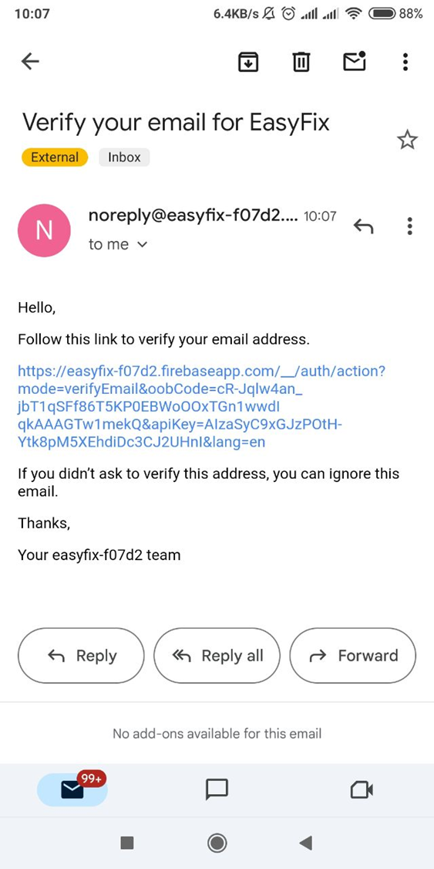
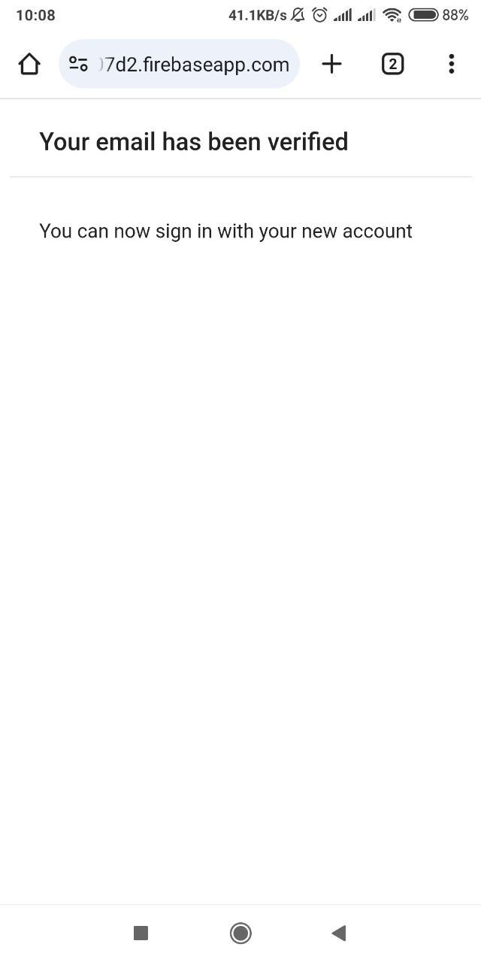
Sign Up Feature Cont.
Notes:
email will sent from firebase system for email verification. after the link is click it will open in a browser and verify the email successfully. without email verification user can’t login the system.

Slide 7
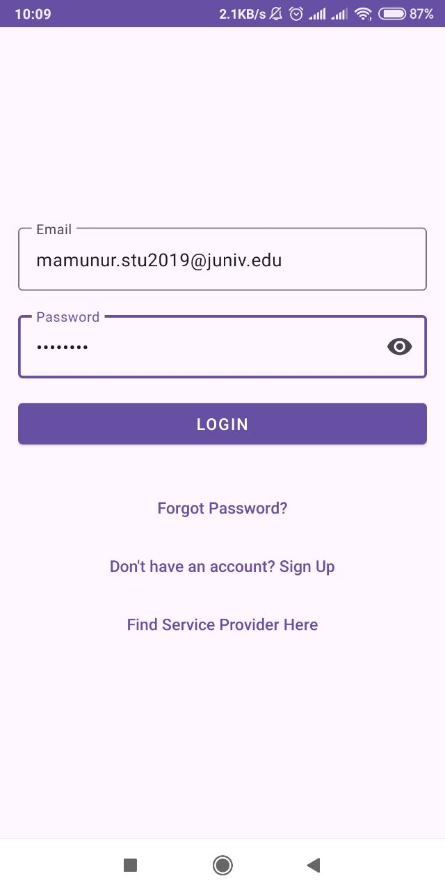
Login Feature
Remember Me Feature
Navigation Button for Sign Up
Navigation Button for Forget Password

Slide 8
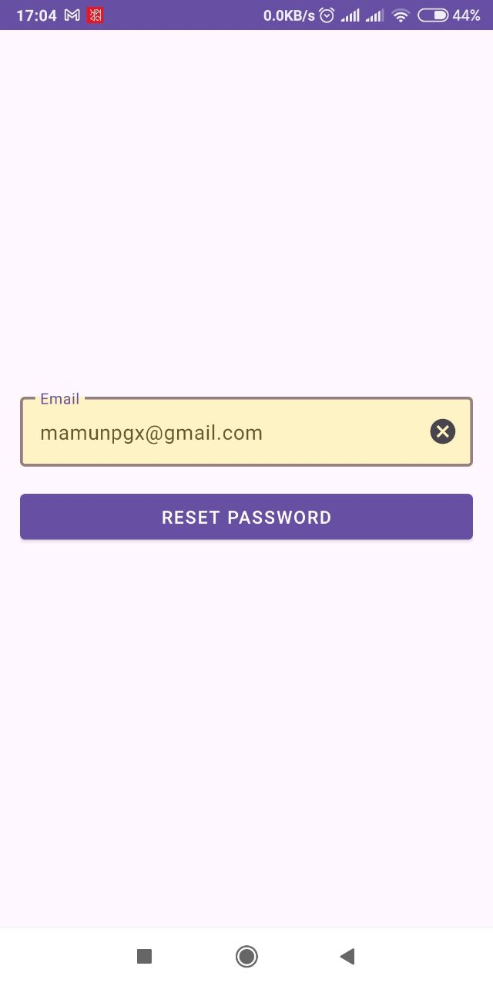
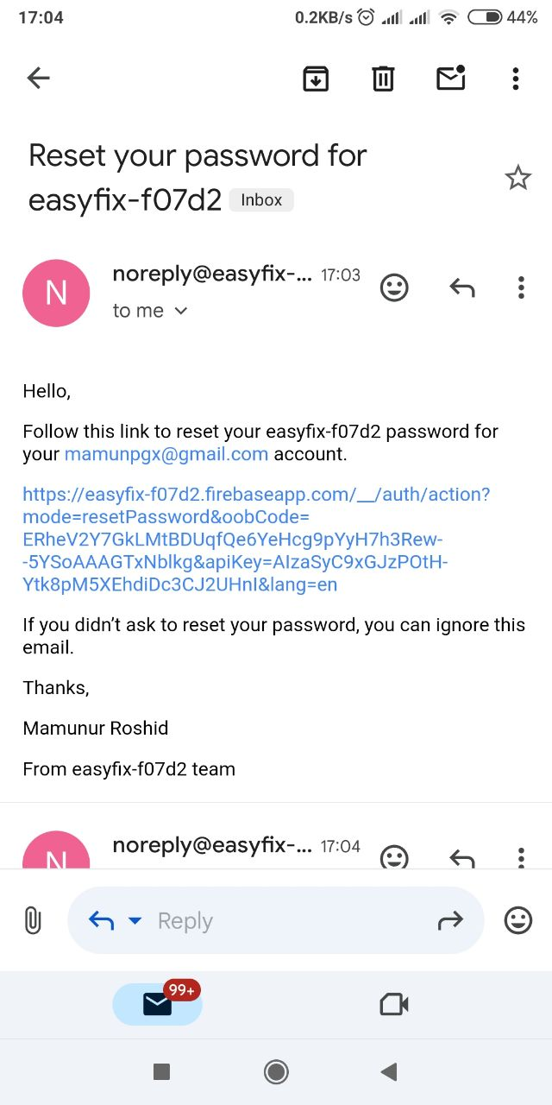
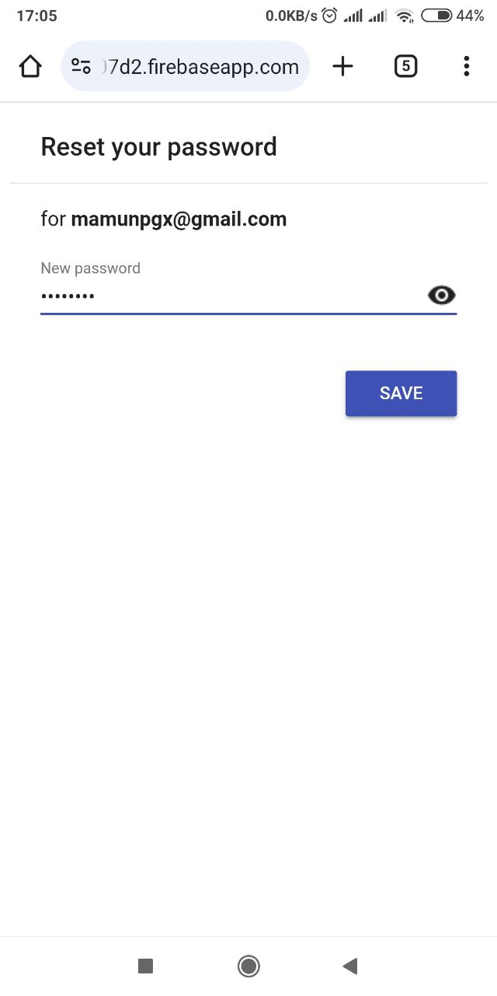
Forget Password Feature

Slide 9
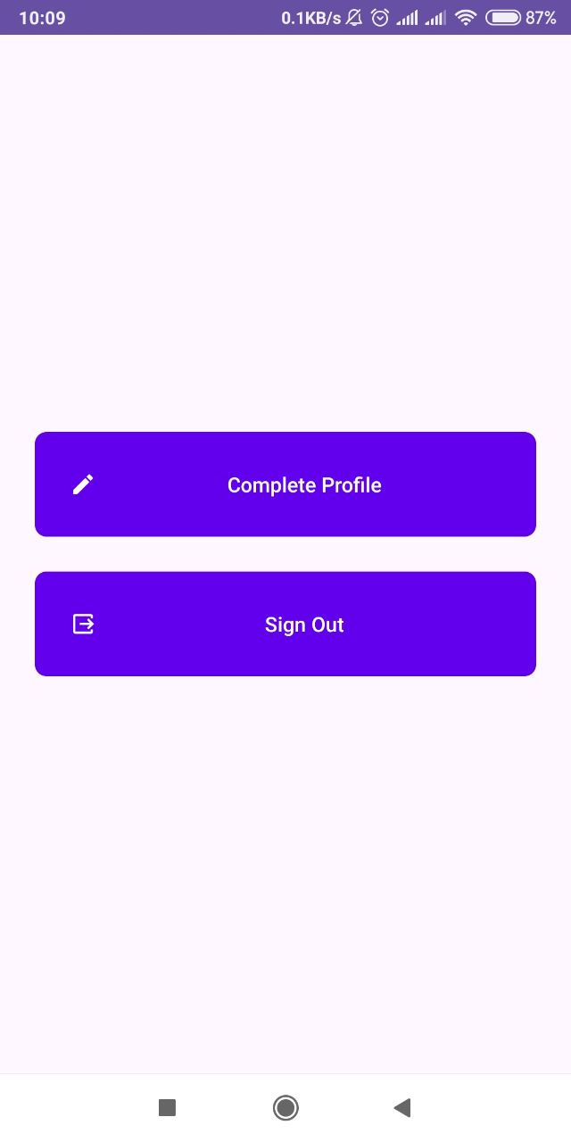
Dashboard for New User

Slide 10
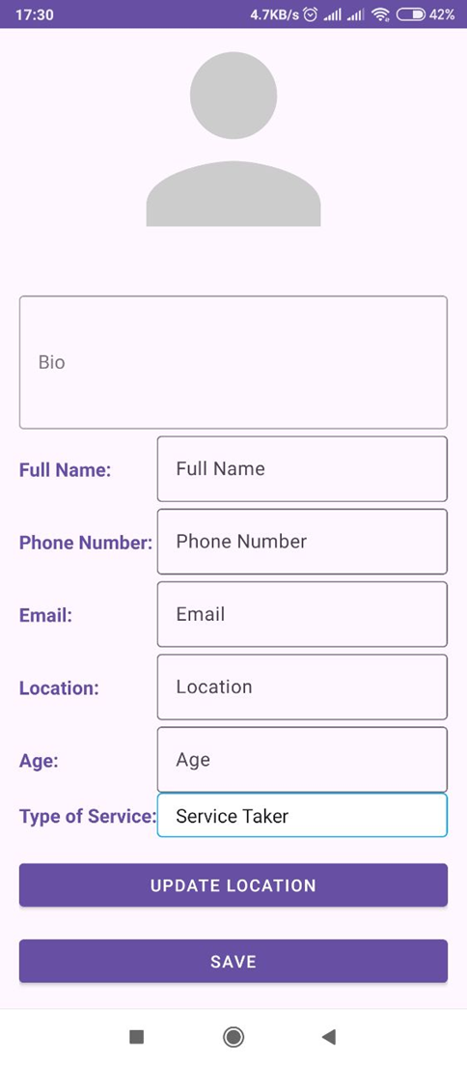
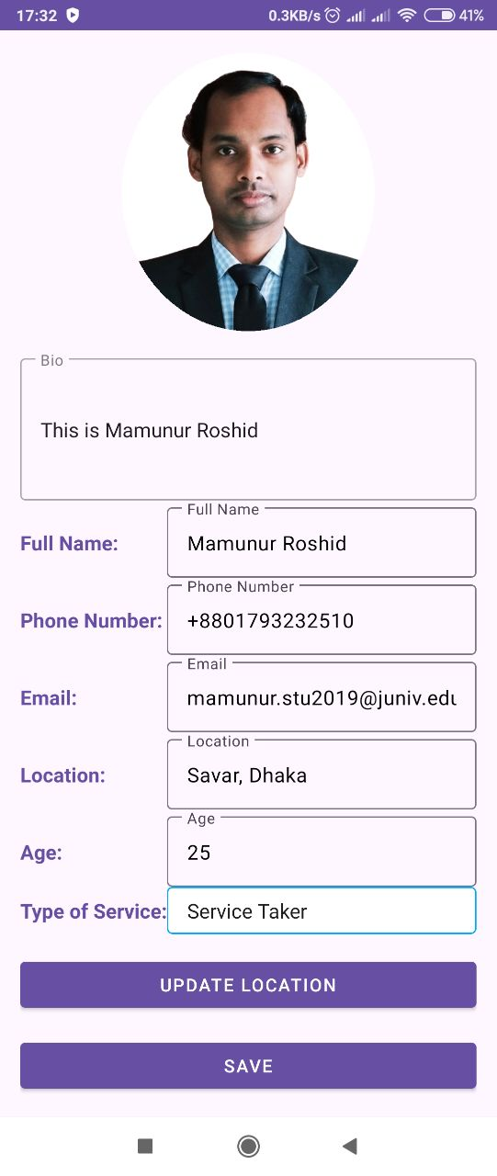
Complete Profile Page

Slide 11
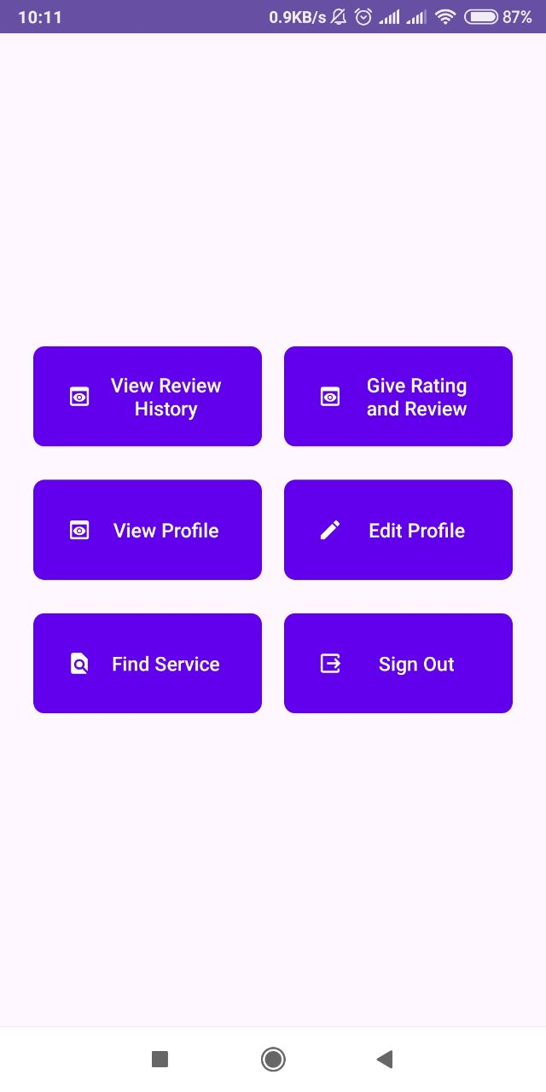
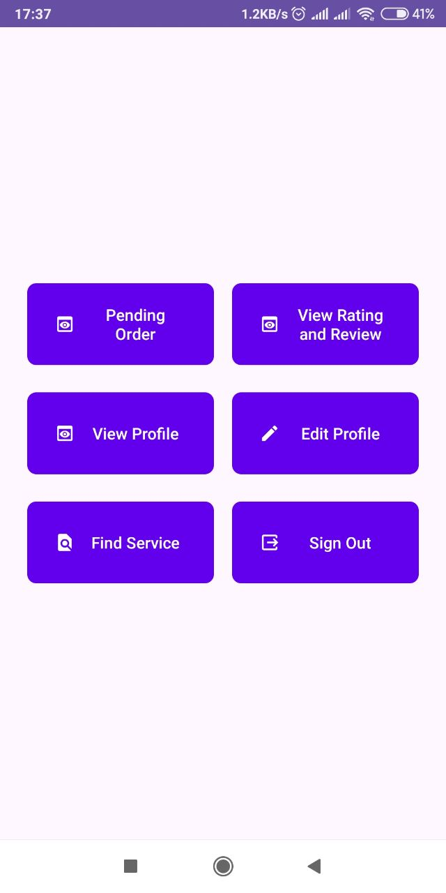
After Complete Profile
For Service Taker
For Service Provider

Slide 12
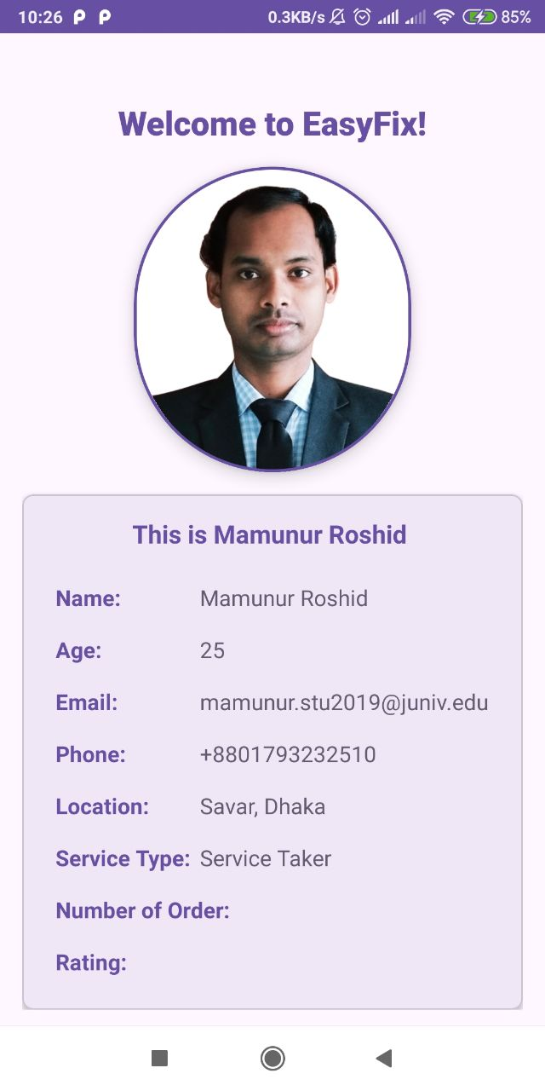
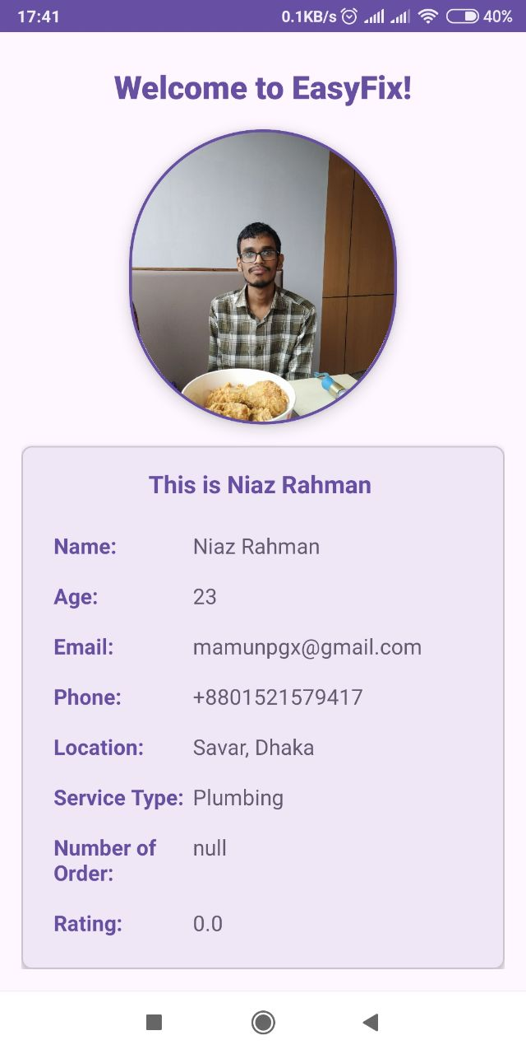
View Profile

Slide 13
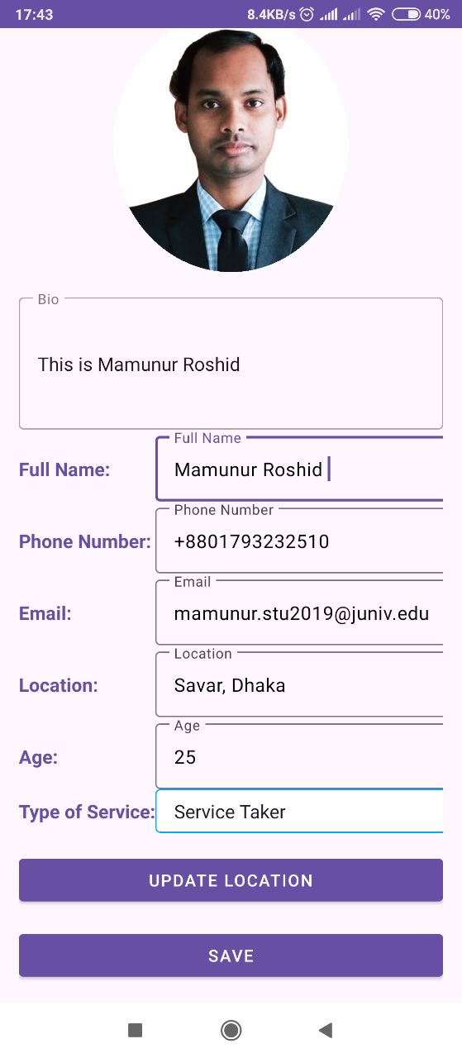
Edit Profile Feature
Can update Bio Description
Can update phone number
Can update Location feature by one click
Change any info except email

Slide 14
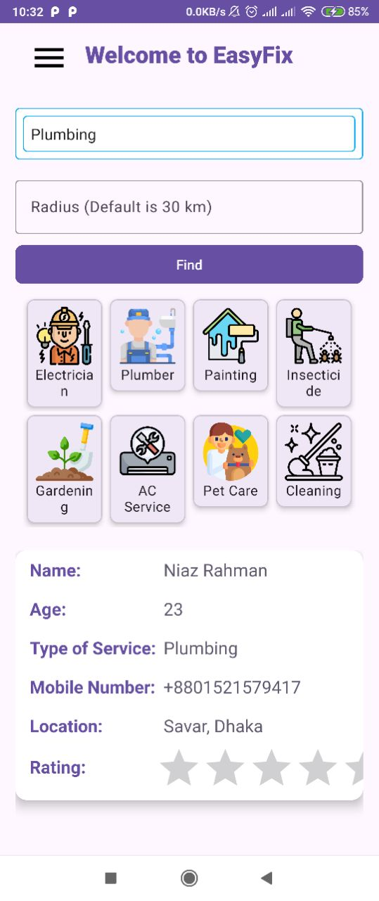
Find Service Feature
Get Service Provider by one click
High Rating service provider will appear first
Fast searching by firebase
Dynamic result list by selecting radius

Slide 15
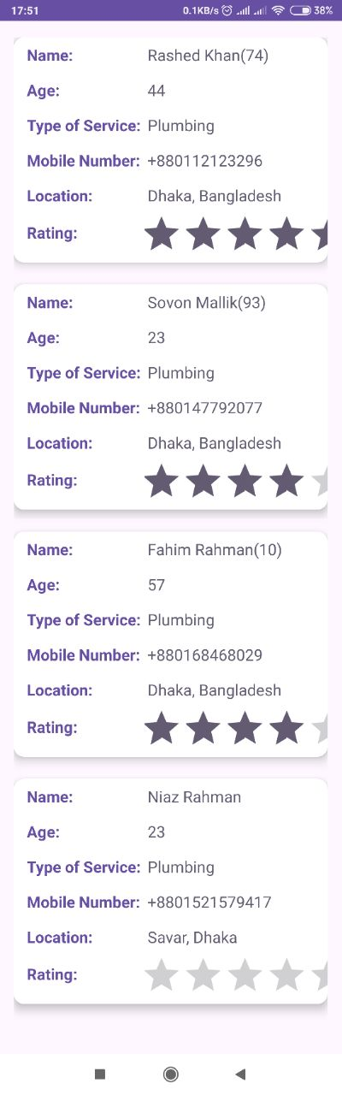
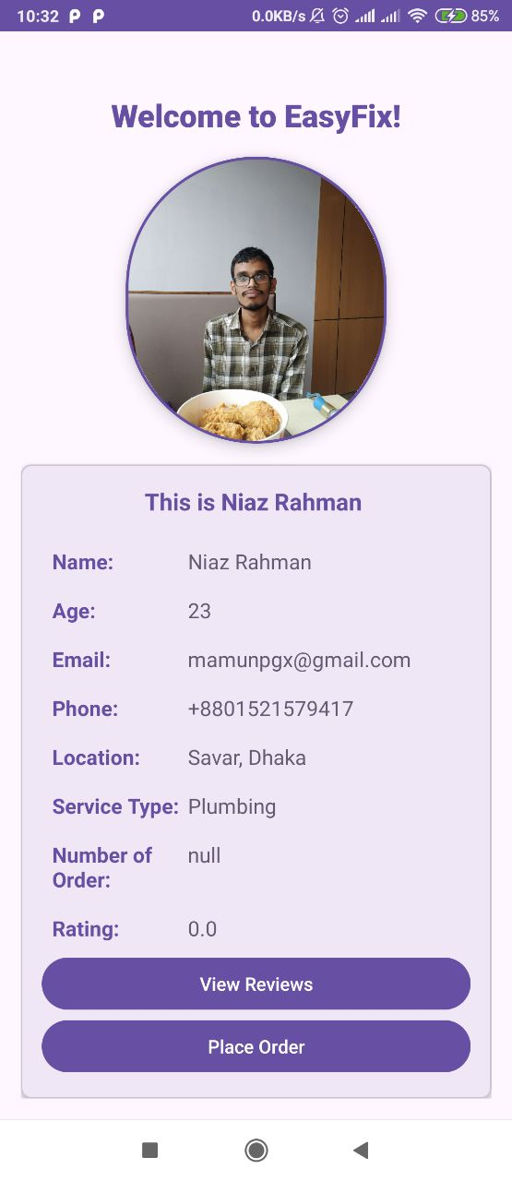
Find Service Cont.

Slide 16
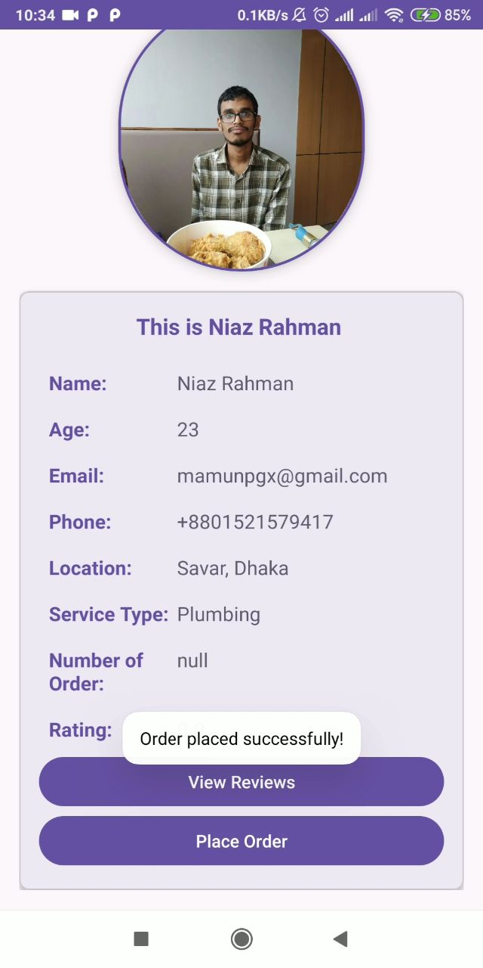
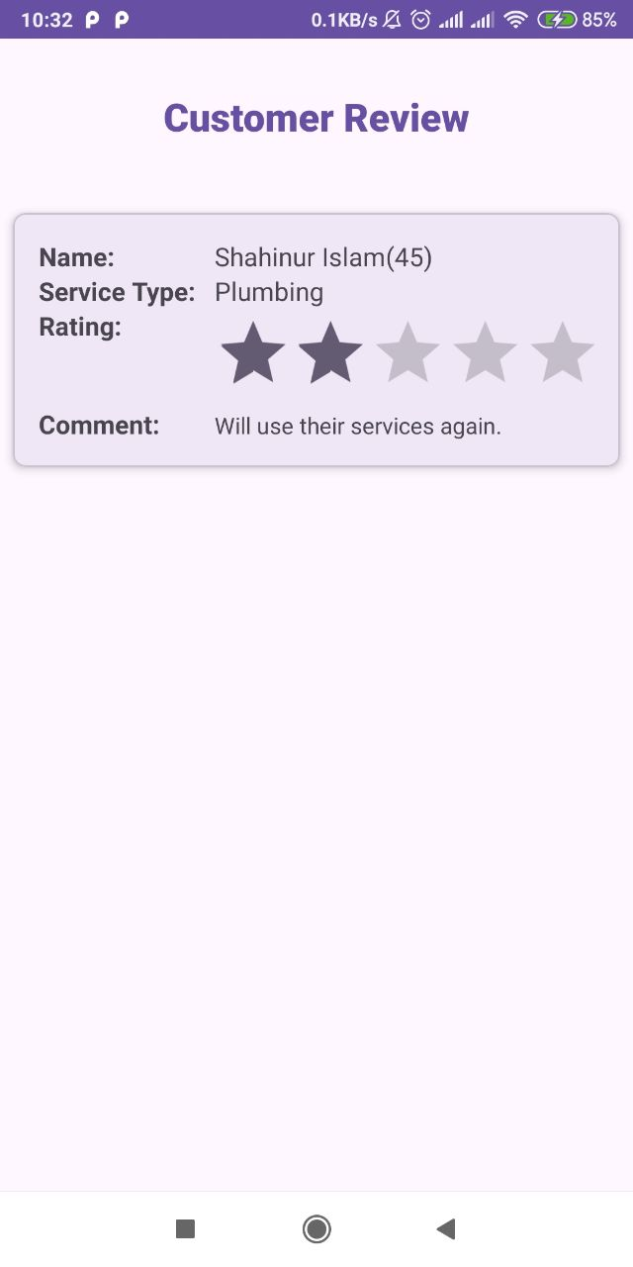
Find Service Cont.

Slide 17
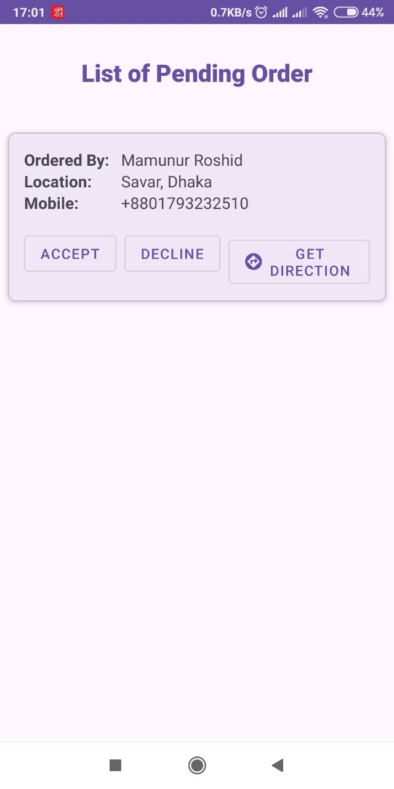
Provider Dashboard

Slide 18
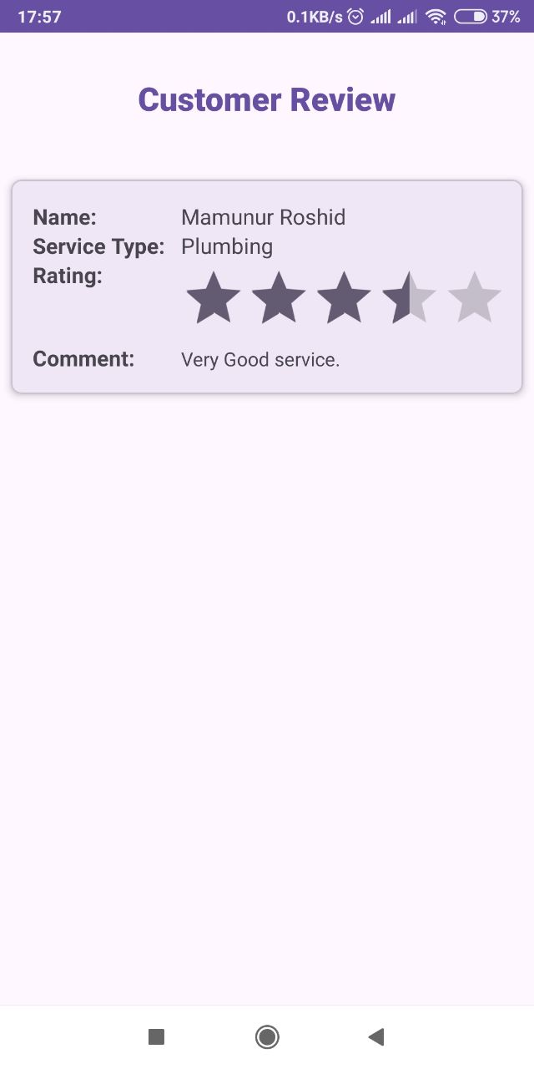
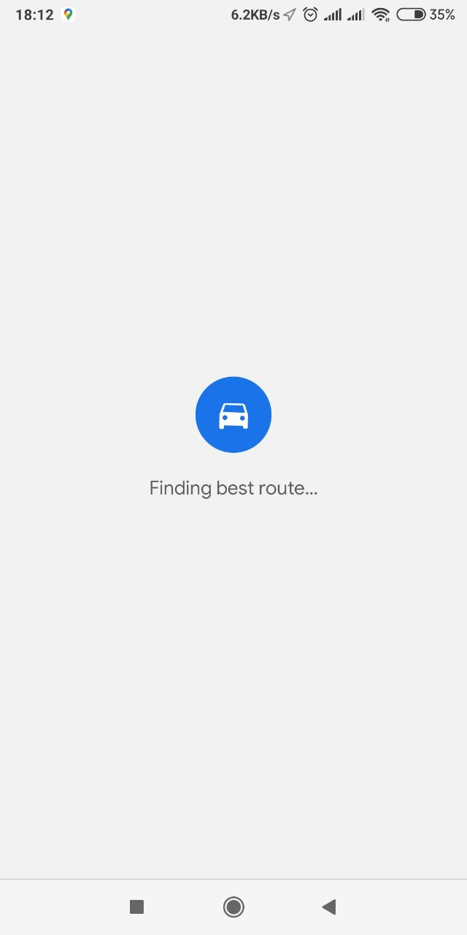
Provider Dashboard Cont.

Slide 19
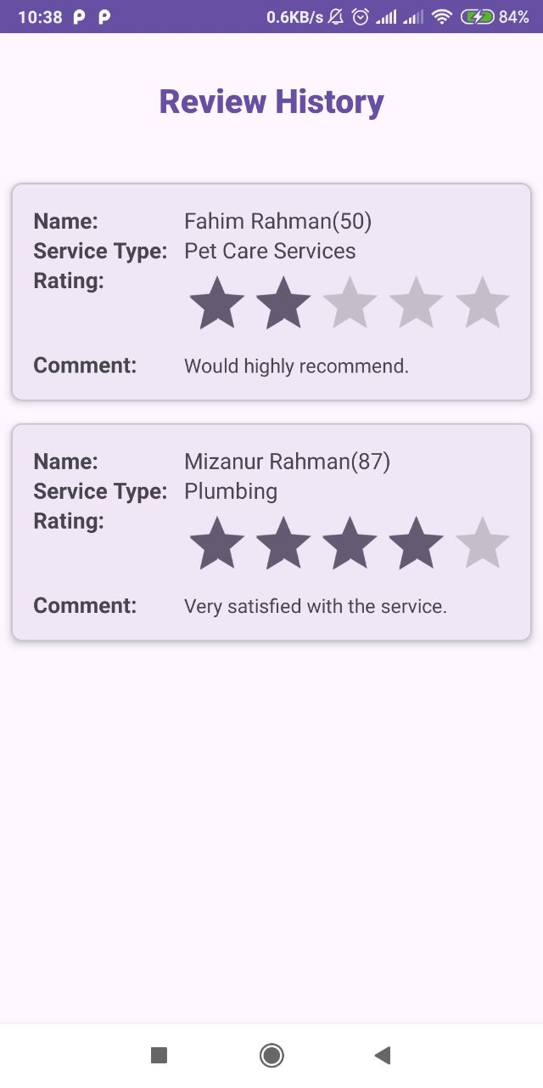
Taker Dashboard

Slide 20
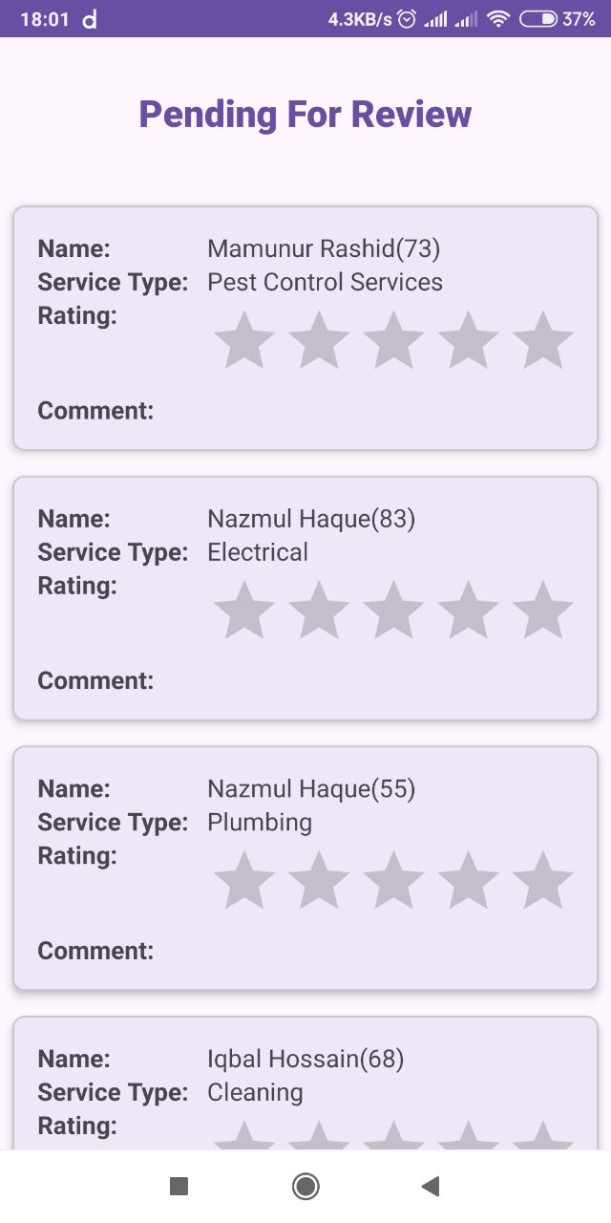
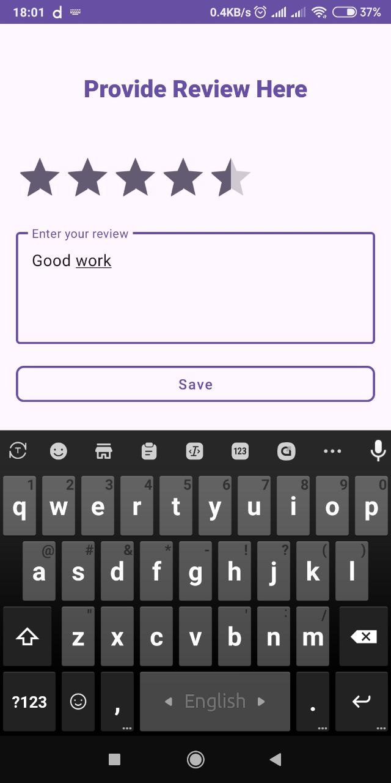
Give Rating

Slide 21
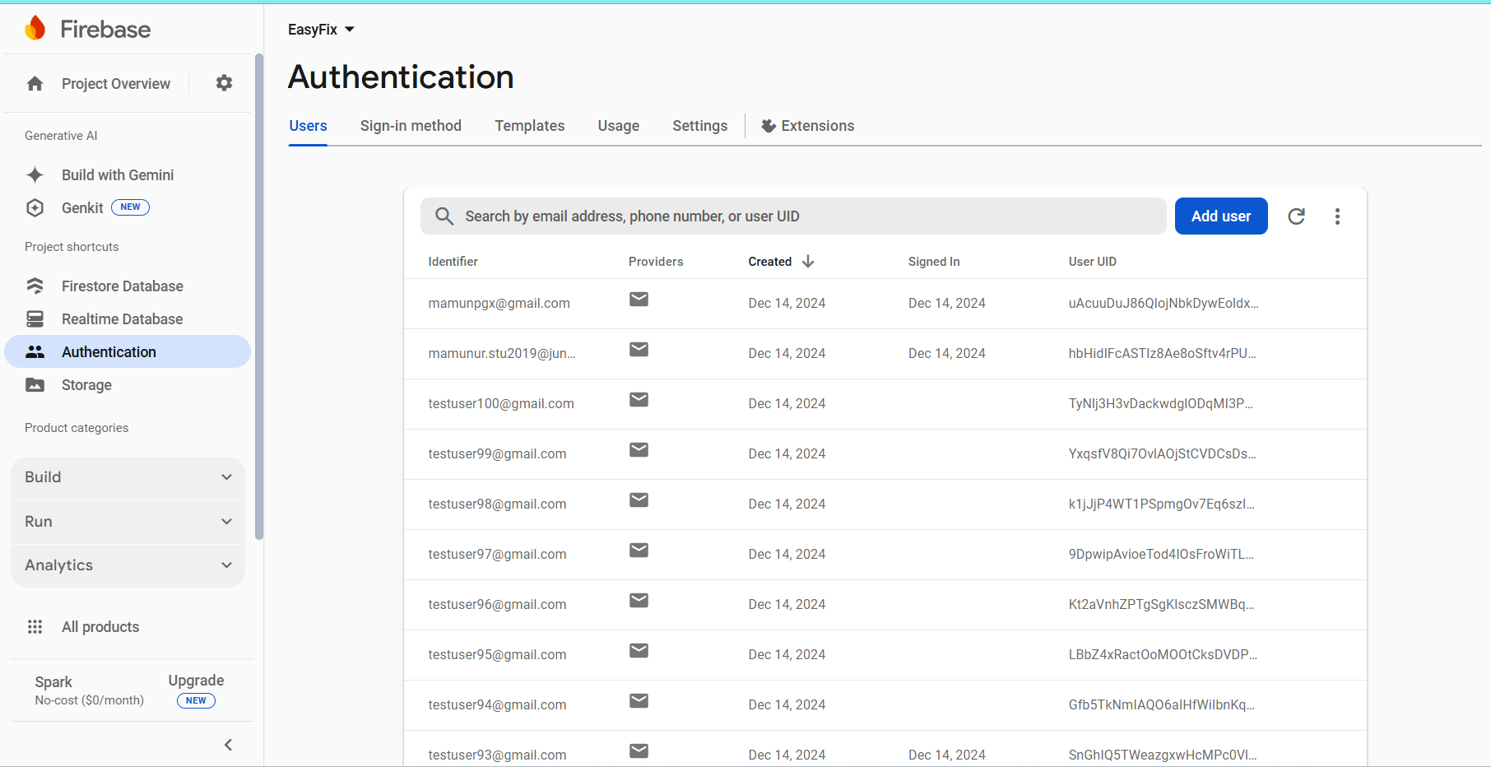

Slide 22
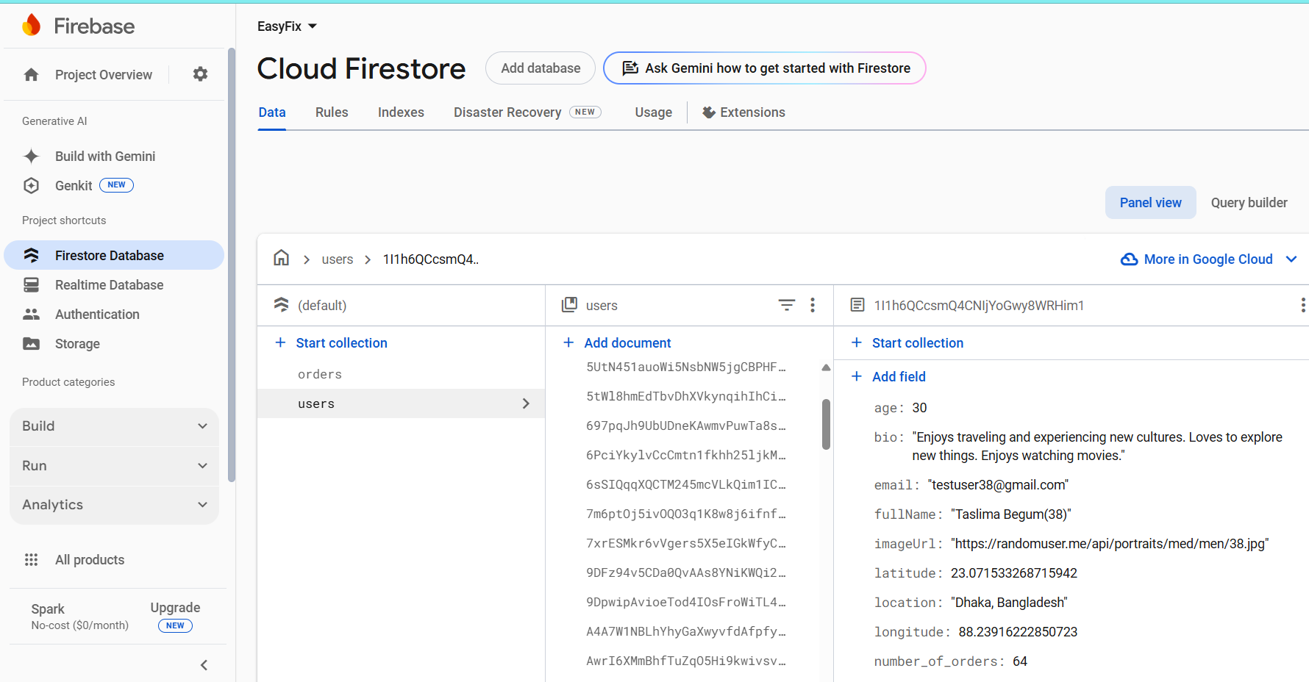

Slide 23
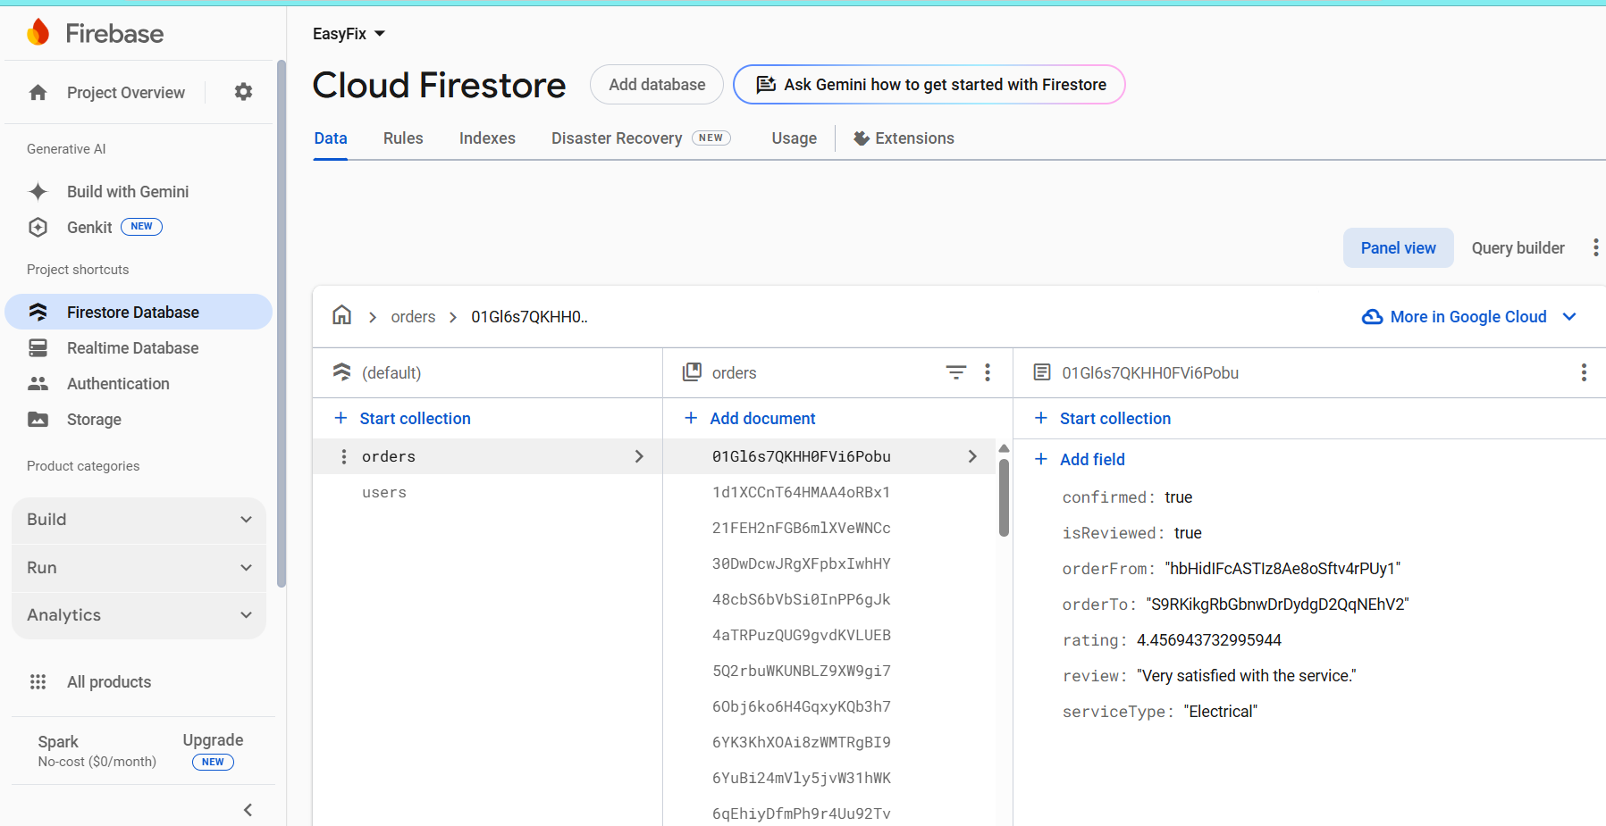

Slide 24
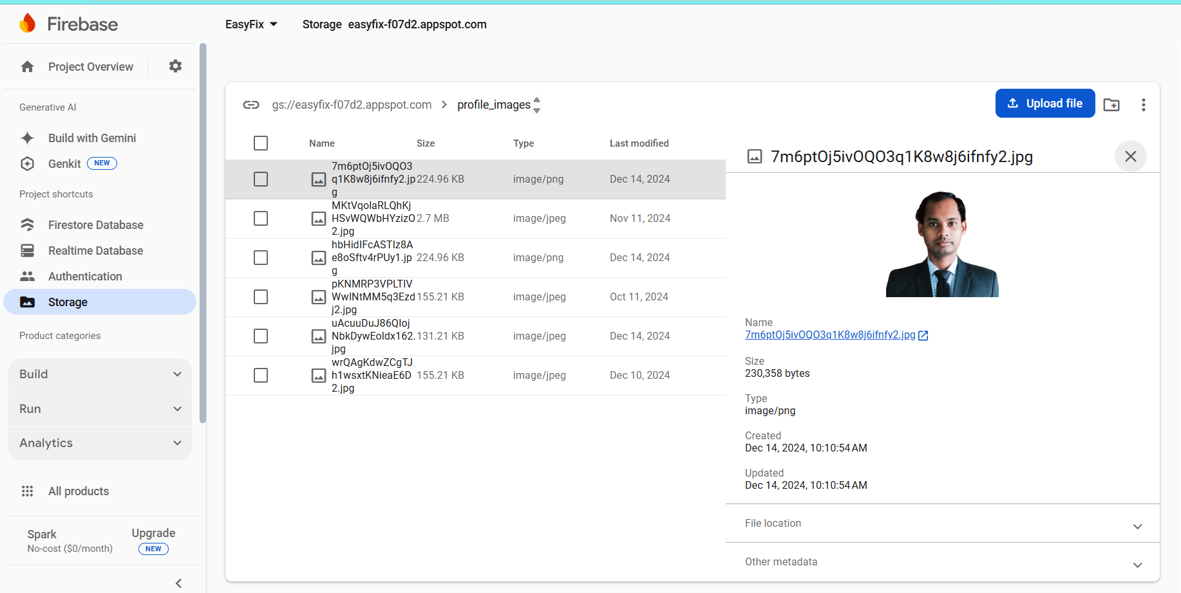

Slide 25
Github Repository Link
https://github.com/mamunurRoshid14/EasyFix

Slide 26
THANK YOU

